Slide 1
Javascript: Stage 2
By:
LiQuan (Edmond) Situ
Shea Bautista-Capol
Matthew Chang
Ocean Lu

Slide 2
Intro
JavaScript is a dynamic computer programming language.
It is lightweight and most commonly used as a part of web pages, whose implementations allow client-side script to interact with the user and make dynamic pages.
Notes:
https://www.tutorialspoint.com/javascript/javascript_overview.htm

Slide 3
Language Features: Data Type
Basic Data Types :
Formal list: ✓ Boolean, ✓ Null, ✓ Undefined, ✓ Number, ✓ String, ✓ Symbol, ✓Object
Character String Types:
Design: JavaScript treats primitive values as objects when executing methods and properties
Operations:
.length(); indexOf(“”); lastIndexOf(“”); search(“”); replace(“”, “”); slice(#, #); substring(#, #); substr(#, #); toUpperCase(); toLowerCase(); concat(“”,str); trim(); charAt(“”); charCodeAt(#); []
Array Types: In Javascript, arrays are a special type of objects
Subscripts are integers, and are range checked; jagged and multidimensional arrays are allowed
Arrays can be initialized when they have their storage allocated
length(); sort(); push(); toString(); pop(); shift(); unshift(); splice(); concat();

Slide 4
Language Features: Control Structures
If-statements
Switch statement
Loops(for, while, do-while)
Break and Continue statements
Syntax for all is very similar to java.

Slide 5
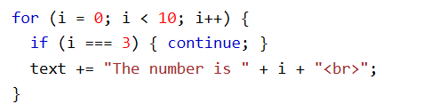
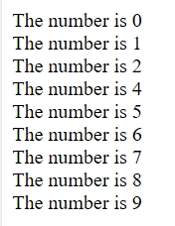
Break and Continue Statement
break; —> breaks out of switch statement or ends loop at current step
continue; —> skips current step in loop without breaking entirely out of it
Example:
Prints out:

Slide 6

Language Features: Function Definitions
Uses “function” keyword
No need to specify return type, will return whatever you need it to
If no return statement is used, returns undefined

Slide 7
Program: https://js.do/code/368936
<script> document.write("<b>#1: PRINT HELLO WORLD USING VARIABLES</b><br><br>"); // To start we will create 2 variables: var variable1 = 'Hello '; var variable2 = 'World!<br><br>'; // <br> means line break in html // Create a third variable by adding both variables: var final_text = variable1 + variable2; // Print the final result: document.write(final_text); document.write("<b># 2: SOLVE AN EQUATION</b><br><br>"); var n = 9; var x = n*n; document.write("Result of n*n=" + x); document.write("<br><br><b>#3: PRINT NUMBERS FROM 1 TO 10</b><br><br>"); // Create a loop of 10 elements. // Variable "i" starts with value 1 and while i<=10 it will increment 1 (i=i+1) for (var i=1; i<=10; i=i+1) { document.write(i); // Print the current "i" number // Print a comma followed by a space if i < 10 if (i<10) { document.write(", "); } } function show_random_number() { var random_number = Math.random(); // generate random number between 0 and 1 alert(random_number); // show popup with a random number } </script> <br><b>#4: CALL A JAVASCRIPT FUNCTION:</b> <input type=button onClick="show_random_number()" value="Generate random number">

Slide 8
Thanks for listening!
Have a great day :-)

Slide 9
Slide Breaker

Slide 10
Javascript: Stage 5
By:
LiQuan (Edmond) Situ
Shea Bautista-Capol
Matthew Chang
Ocean Lu

Slide 11

Intro
JavaScript is a dynamic computer programming language.
It is lightweight and most commonly used as a part of web pages, whose implementations allow client-side script to interact with the user and make dynamic pages.
Notes:
https://www.tutorialspoint.com/javascript/javascript_overview.htm

Slide 12
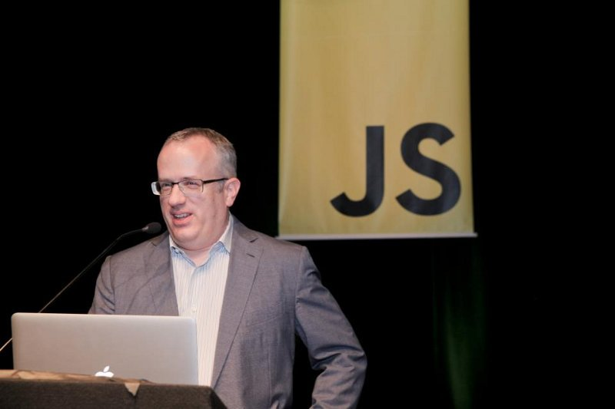
Language Evolution: Origin
JavaScript was created by Brendan Eich in 10 days, in May 1995 at Netscape Communications.
A scripting language that would have a similar syntax and complement Java.
Developed under the name Mocha, then officially called LiveScript in beta releases, renamed to JavaScript when deployed in the Netscape Navigator.
Notes:
https://en.wikipedia.org/wiki/JavaScript

Slide 13
Language Evolution: Purpose
Aim to turn the Web into an application platform and designed to complement Java
Java - server side applications
Javascript - client side applications

Slide 14
Language Evolution: Versions
Official name: ECMAScript
ECMA - European Computer Manufacturers Association
ECMAScript 1 (1997) - First Edition
ECMAScript 10 (2019) - Latest Version
ECMAScript 3 is fully supported in all browsers
ECMAScript 5 is fully supported in all modern browsers

Slide 15
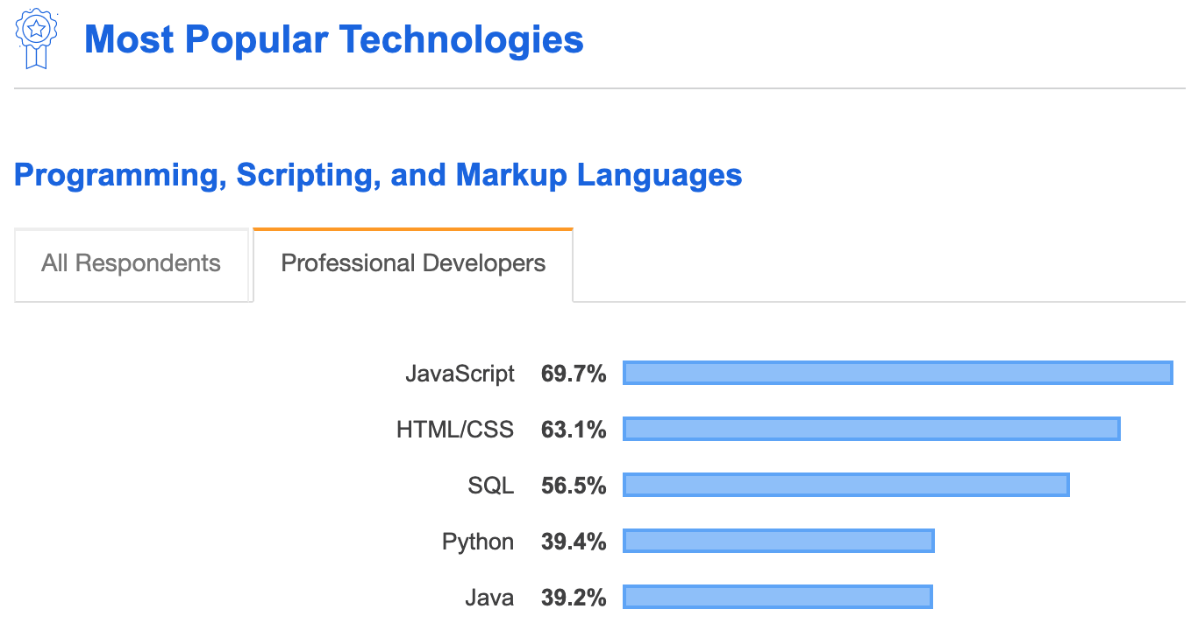
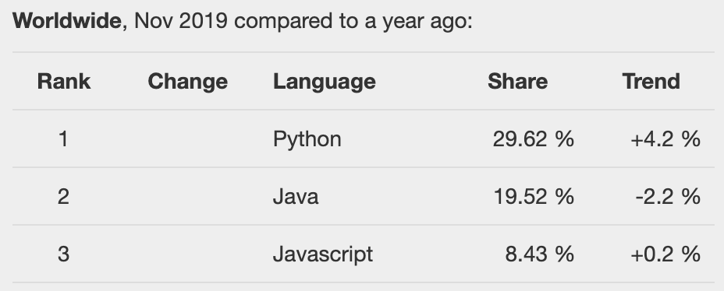
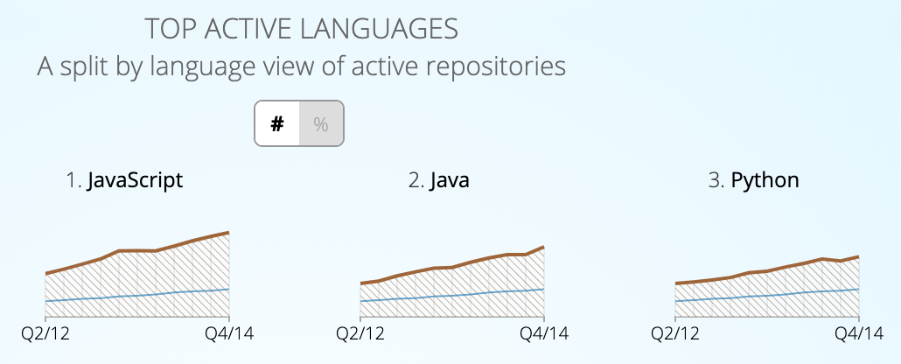
Language Evolution: Popularity
Notes:
Stack Overflow - https://insights.stackoverflow.com/survey/2019
Google Trends - http://pypl.github.io/PYPL.html
Github - https://githut.info/

Slide 16
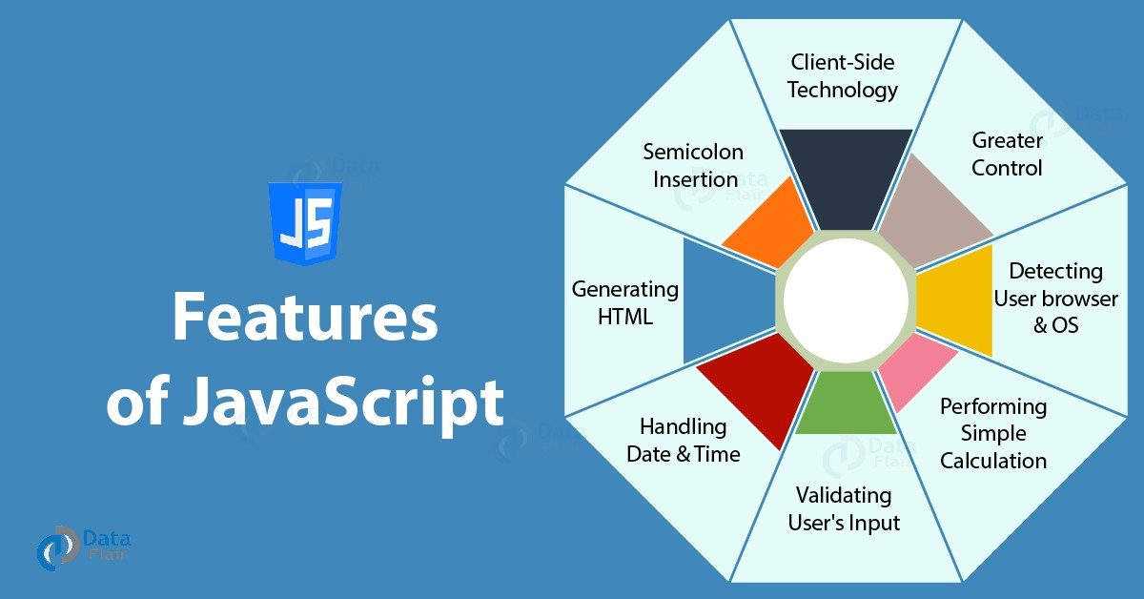
General Features
Notes:
https://data-flair.training/blogs/features-of-javascript/
https://medium.com/@aakash.bachheriya123/8-amazing-features-of-javascript-just-for-you-9660ca1301a6
https://www.webdesign.org/web-programming/javascript/4-powerful-features-of-javascript-programming-language.17008.html

Slide 17
Advanced Features
Support for both functional and object-oriented approaches
Portable
Supported on all browsers

Slide 18



Advance Features - Code
let/const: alternative to “var,” only accessible in code block initially defined in
Arrow functions: alternative way to define functions, shortens code
Template literals: safer, cleaner alternative to basic strings
Default Parameters: allow default values to be assigned to a functions parameters
Property Shorthand: define object properties with less code

Slide 19
Project Demo - Notes
Goal: display location on top, display weather on bottom, and change Fahrenheit and Celsius on click
app.js: we ask the user to allow us location (navigator.geolocation) because we need to get our longitude and latitude
Darksky API is free (https://darksky.net/) & allows us to look up the weather anywhere on the globe. To call this, we need the lat and long at the end of the url, that we found with our user’s position.coords.latitude/longitude
After we get our location with the API and receive a JSON file, so we can use it in our Javascript
onClick function with specific formulas that match Celcius and Farenheit

Slide 20
Project Demo - Styling
Styling: we have container that fills the background, allowing full screen, aligned center.
Background color is a linear gradient, inside .container (matches our div class="container" in index.html)
Icons used from skycons which are canvas elements and you define a sky con and you add a canvas in your HTML and you say what kind of SVG you want to use in your canvas.
They are declared skycons = new Skycons and then add an icon by skycons.add("icon1" (the ID), (and then what kind of icon it should display) Skycons.PARTLY_CLOUDY_DAY), etc
Icons : https://darkskyapp.github.io/skycons/

Slide 21
Key Demo Code - Get longitude & latitude → weather
if(navigator.geolocation) { navigator.geolocation.getCurrentPosition(position => { long = position.coords.longitude; lat = position.coords.latitude; const proxy = 'https://cors-anywhere.herokuapp.com/'; const api = `${proxy}https://api.darksky.net/forecast/03af9c9f856c8c0e0408cda48b335ea9/${lat},${long}`; fetch(api) .then(response =>{ return response.json(); }) .then(data => { const {temperature,summary, icon} = data.currently; temperatureDegree.textContent = temperature; temperatureDescription.textContent = summary; locationTimeZone.textContent = data.timezone; setIcons(icon, document.querySelector('.icon')); }); }); } else { h1.textContent = "Location is not enabled"; }

Slide 22
Key Demo Code - Styling & Celcius/Farhenheit switch
temperatureDegree.addEventListener("click", tempConverter); function setIcons(icon, iconID) { const skycons = new Skycons({color: "white"}); const currentIcon = icon.replace(/-/g,"_").toUpperCase(); skycons.play(); return skycons.set(iconID, skycons[currentIcon]); } function tempConverter() { var temp = parseFloat(temperatureDegree.textContent); var newTemp; if (fahrenheit) { newTemp = (temp-32) * (5/9); temperatureType.textContent = "C"; fahrenheit = false; } else { newTemp = temp * (9/5) + 32; temperatureType.textContent = "F"; fahrenheit = true; } temperatureDegree.textContent = newTemp.toFixed(2); } });

Slide 23
Project Demo - Weather App

Slide 24
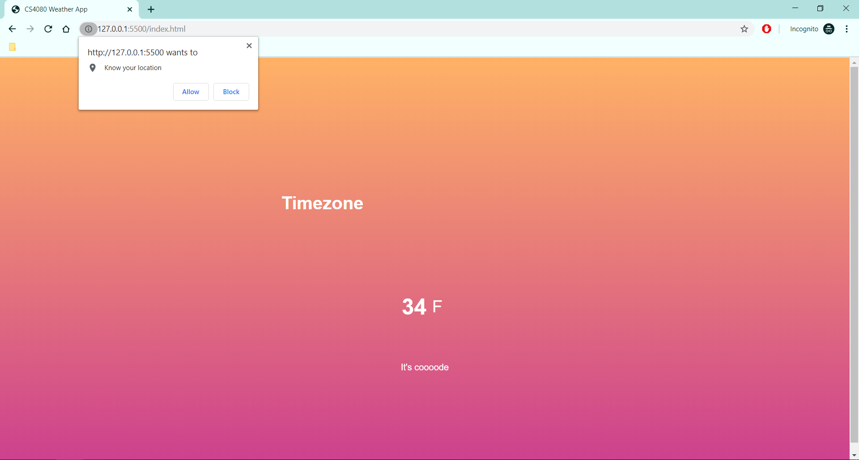
Key Screenshots: Ask for User location

Slide 25
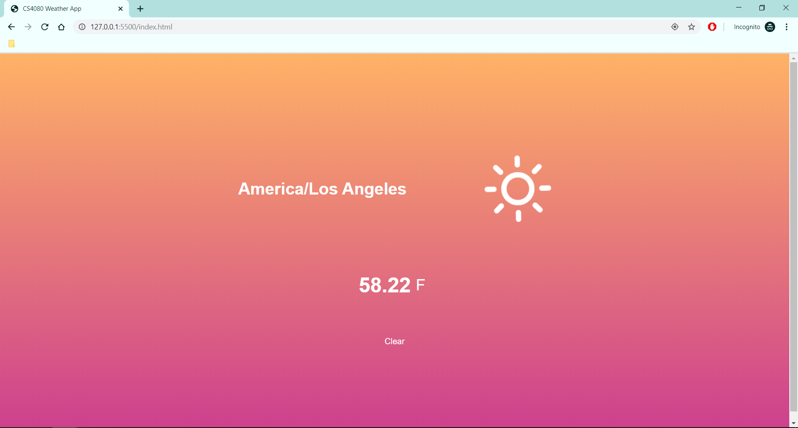
Key Screenshots: Fahrenheit Display (default)

Slide 26
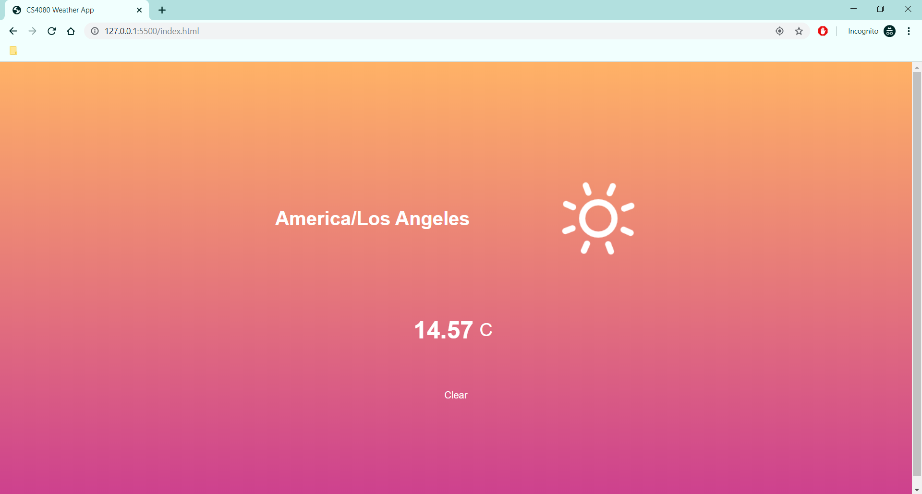
Key Screenshots: Celsius Display (on click)

Slide 27
Thanks for listening!
Have a great day :-)

